Slide 1
Higher education 2024/25

Slide 2
Choosing a course
Over 50,000 degree courses available
Over 395 institutions offer degree courses, and over 100 are universities.
Viticulture and Oenology
Live Music
Ethical Hacking
Sports Therapy
Journalism
Outdoor Studies
Sports Media
Strength & Conditioning
Business Studies
Acting
Special Educational Needs
Early Childhood Studies
Secondary Teaching
Youth Work
English Literature
Football Coaching
Creative Writing
Brewing and Distilling

Slide 3
DIFFERENT TYPES OF HIGHER EDUCATION QUALIFICATIONS
Foundation Diploma – Art, Fashion, Photography
Foundation Degrees – Marine Sport, Forensic Science, Animal Behaviour & Psychology, Zoo Conservation
B.Sc. B.A B.Ed B.A. (QTS) LLB
MSci/MEng
Medicine, Dentistry, Veterinary Science
Joint, Major/Minor, Sandwich
What do you enjoy?
What are you good at?
What career do you wish to follow?

Slide 4
Admissions Tests
UCAT – Medicine
BMAT – Medicine
LNAT – Law
ELAT and HAT for English and History at Oxford
STEP – Mathematics
Thinking Skills Assessments for Oxford & Cambridge
Costs
Dates

Slide 5
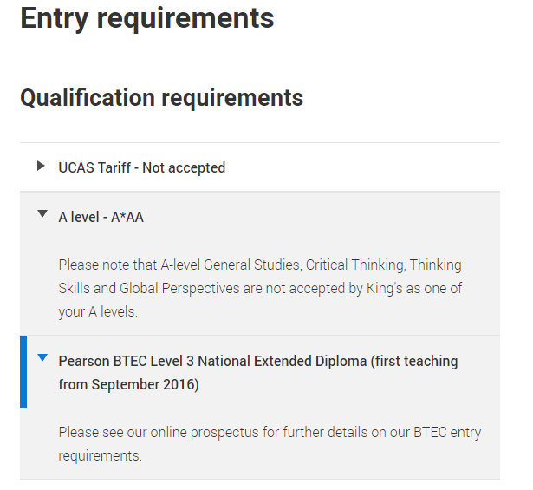
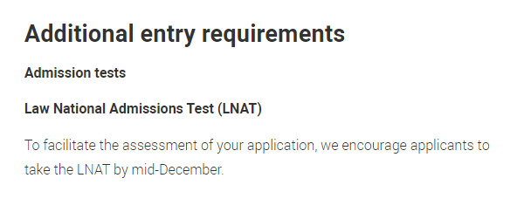
Entry Requirements

Slide 6
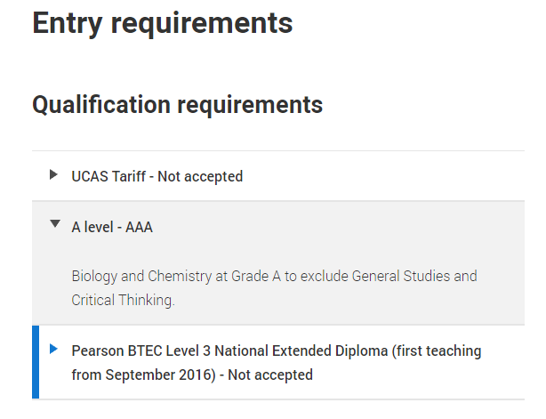
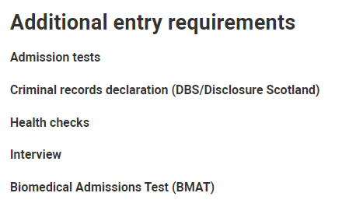
Entry Requirements

Slide 7
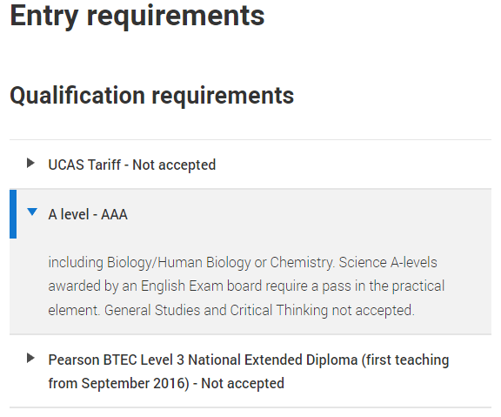
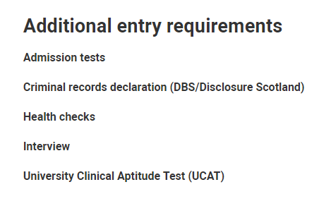
Entry Requirements

Slide 8
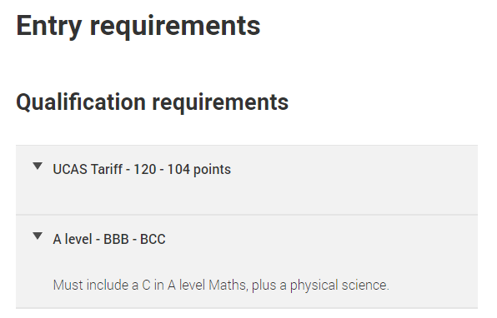
Entry Requirements

Slide 9
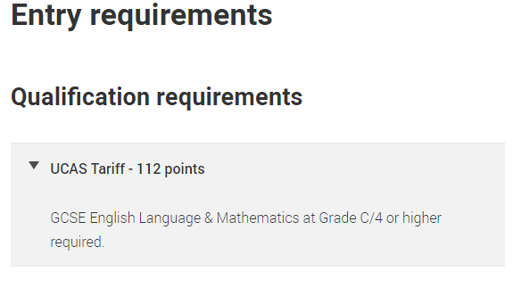
Entry Requirements

Slide 10
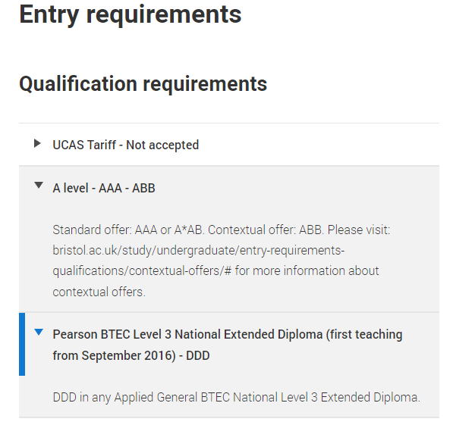
Entry Requirements
Contextual offers | Study at Bristol | University of Bristol

Slide 11
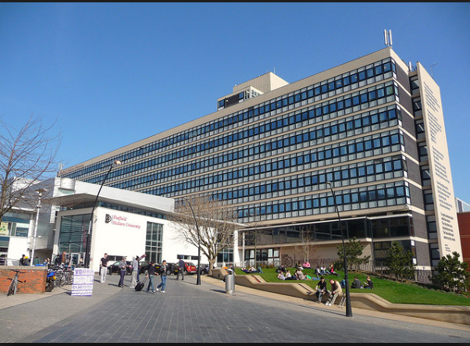

Slide 12
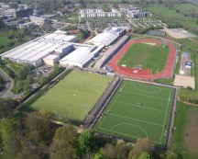
Other benefits?

Slide 13
Tretherras UCAS process
Student registers and completes online application.
This is sent to NT6 team.
Student informs form & subject tutors who compile subject comments into a reference. (UNIFROG)
AJB/HMB/ECJ proof reads application and reference.
Application sent to UCAS, who then send it to all institutions at the same time
Universities make a decision and place on UCAS
Students access the tracking process through their personal UCAS portal
Offer can be Unconditional, Conditional or a rejection.
Offer may be grades A*A*A or BBB or 120 points
Accept one as Firm choice and another as Insurance
Extra choice allowed for anybody not getting an offer. This is called UCAS Extra.

Slide 14
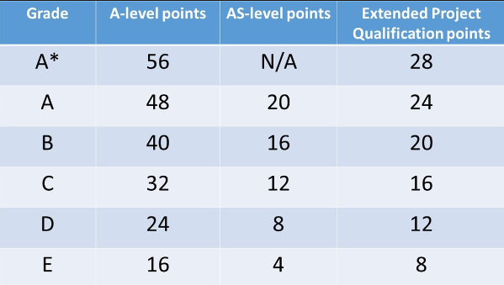
NEW UCAS TARIFF

Slide 15
UCAS Universities & Admissions Services
Use Unifrog & UCAS to search for Uni courses
UCAS Apply is the only way to complete an application
Up to 5 choices
Cost of UCAS application for 2025 is £28.50
Only allowed 4 Medicine/Dentistry/Vet choices
You can only apply to Oxford or Cambridge

Slide 16
PERSONAL STATEMENT
A personal statement should aim to persuade university admission tutors why they should choose you over other similarly qualified students.
Two thirds should be devoted to the subject chosen.
Use specific examples, not general statements.
What have you enjoyed studying and why?
What have you read outside of school that is relevant?
Extra-curricular should focus on transferable skills.
Sport, D of E, Volunteer work, Charity week and other achievements.
It will be used to start an interview.
If you are taking a gap year, state what you intend to do.
BE PREPARED TO REDRAFT SEVERAL TIMES IF NECESSARY!!!

Slide 17
Dates – set in stone!
UCAS search tools, advisor portal & UCAS 2024/25 application cycle already open.
5th September – Completed 2024/25 entries can be submitted
16th October – Medicine/Dentistry/Veterinary and any course at Cambridge or Oxford
13th December – Tretherras deadline
31st January – Equal consideration date for most undergraduate courses
28th February – Start of UCAS Extra
Feb/Mar to 31st May – Finance applications
30th June - Applications after this date will be automatically sent to clearing
30th June - Deadline for making a decision or applying on UCAS Track if you receive all decisions by 31st March
15th August – Results day

Slide 18
What are degree apprenticeships?
A degree apprenticeship enables you to gain a full undergraduate or master’s degree while you work. Degree apprenticeships take three to six years to complete, depending on the course level.
You’ll spend most of your time working and you’ll also study part-time at university. For example, you might go to university one or two days per week, or in short blocks, such as a week at a time. Overall, you spend about 20% of your time studying vs. 80% of your time working.

Slide 19
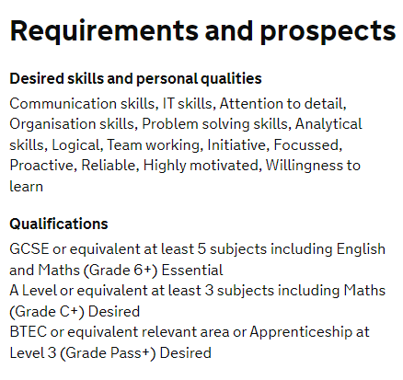
Examples of degree apprenticeships

Slide 20
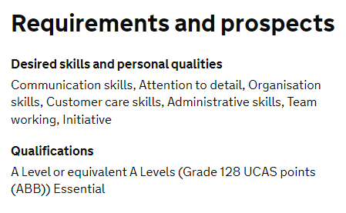
Examples of degree apprenticeships

Slide 21
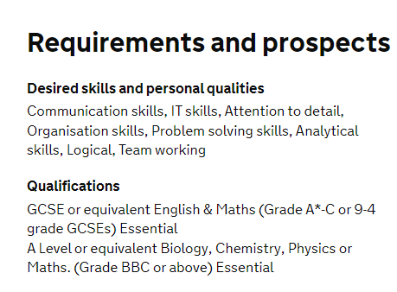
Examples of degree apprenticeships

